Slide 1
APPLYING MACHINE LEARNING ALGORITHMS FOR PATTERN RECOGNITION TO AUTOMATE DETECTION OF ANOMALIES IN INTERNET BANKING SYSTEM
STUDENT: HASAN FARAJOV
SUPERVISOR: AHMAD AHMADZADA
GROUP: BBA-019

Slide 2
ABOUT DATA SCIENCE CONSULTING INFOGRAPHICS
hi

Slide 3
ABOUT DATA SCIENCE CONSULTING INFOGRAPHICS
CHECKLIST
Add your task here | X
Add your task here
Add your task here
Add your task here
Add your task here | X
TASKS FOR TODAY
Venus is the second planet from the Sun
Despite being red, Mars is very cold
Saturn is not the only planet with rings

Slide 4
ABOUT DATA SCIENCE CONSULTING INFOGRAPHICS
This template

Slide 5
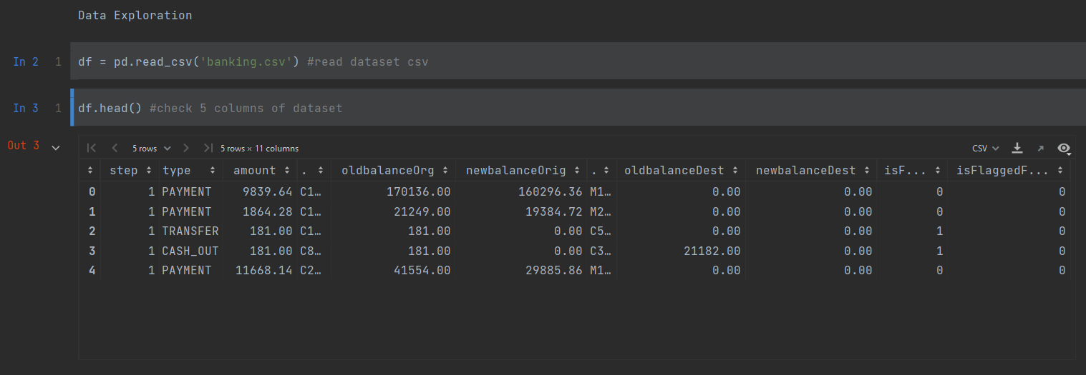
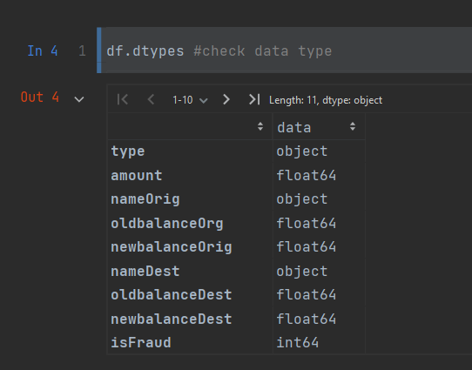
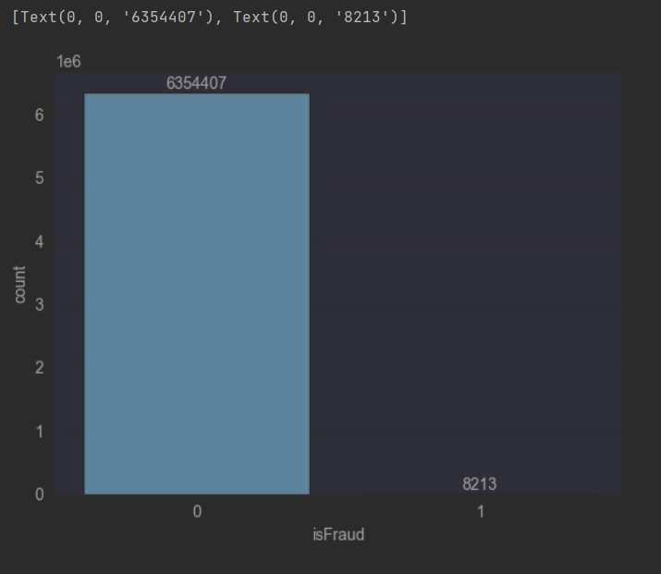
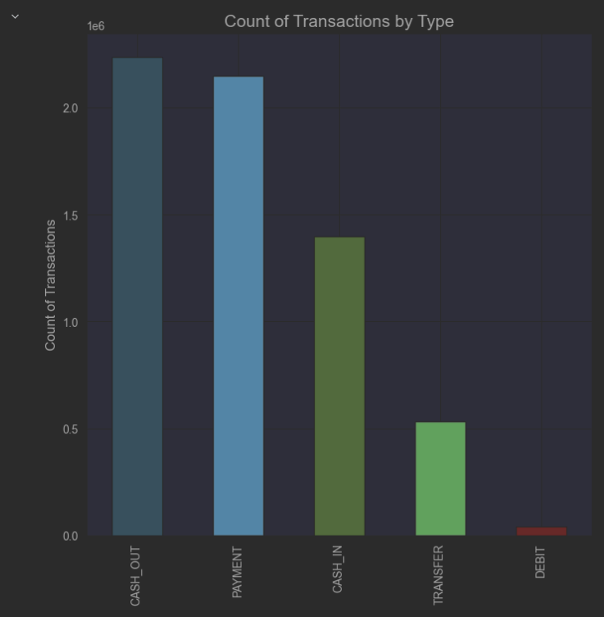
DATA EXPLORATION

Slide 6
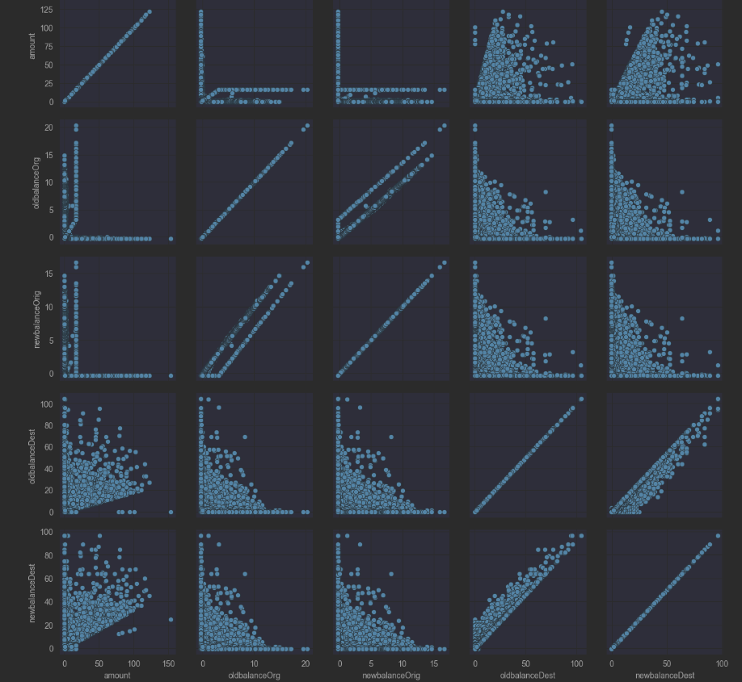
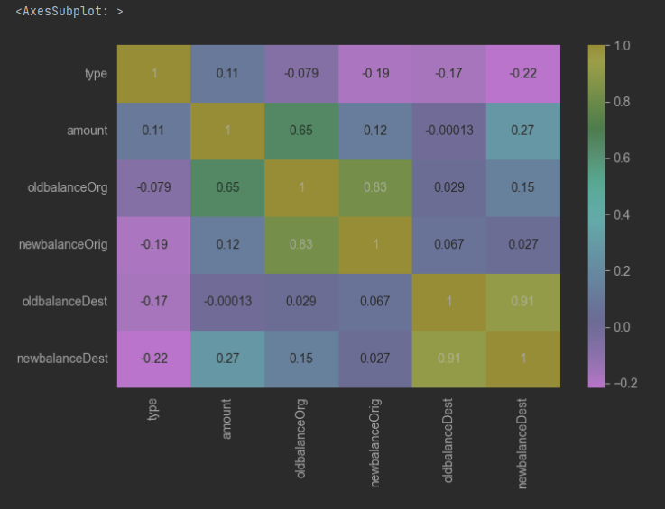
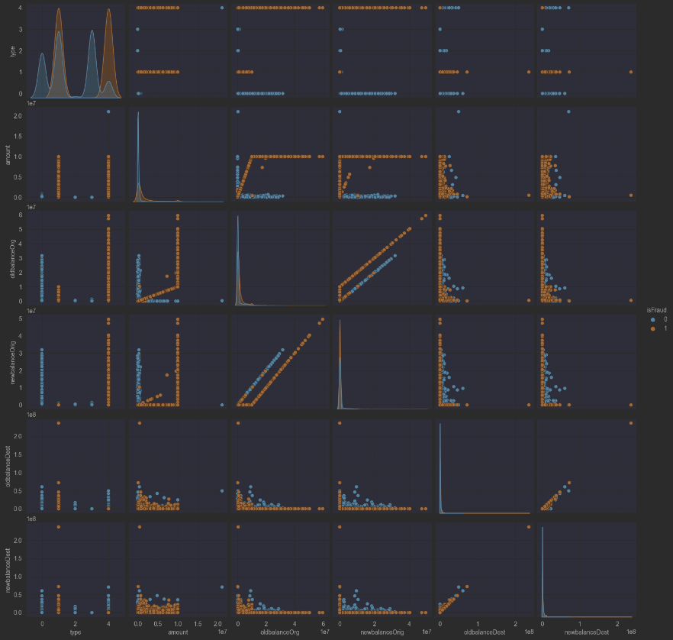
DATA EXPLORATION

Slide 7

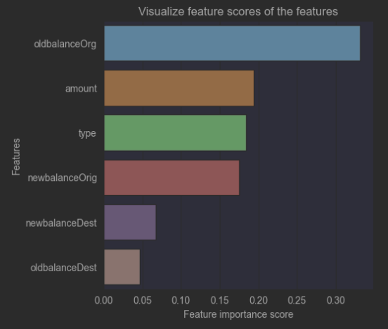
FEATURES ENGINEERING: FEATURE IMPORTANCE BY RANDOM FOREST

Slide 8
EXPLORING CLASSIFIERS TO BUILD FINAL MACHINE LEARNING MODEL
ML Algorithms
K-NEAREST NEIGHBORS
RANDOM FOREST
LOGISTIC REGRESSION
DECISION TREE
NAIVE BAYES

Slide 9
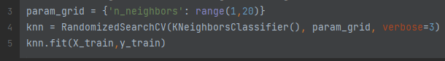
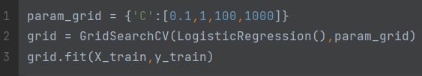
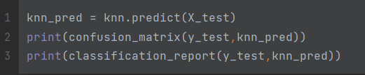
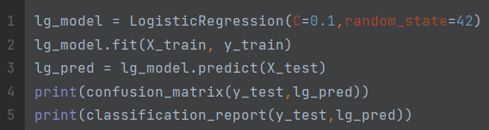
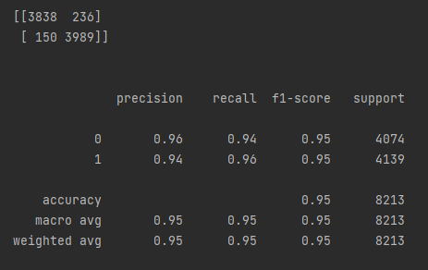
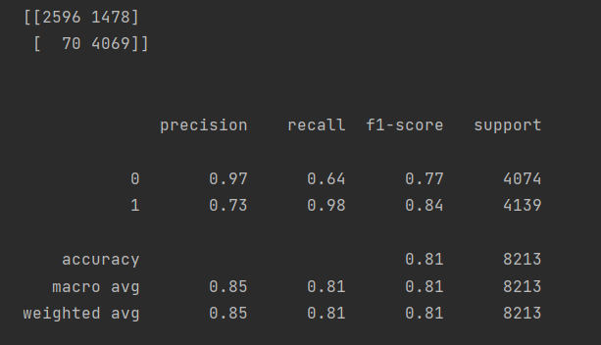
KNN
LOGİSTİC REGRESSİON

Slide 10
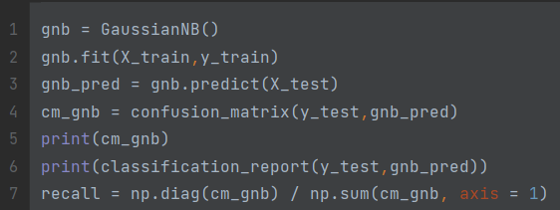
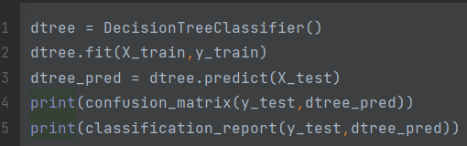
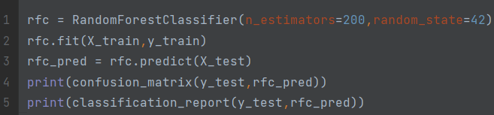
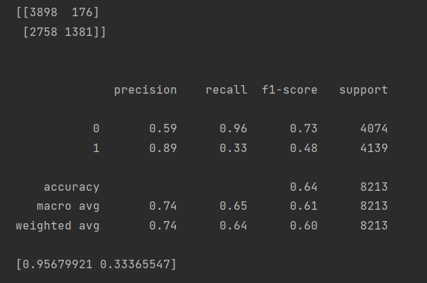
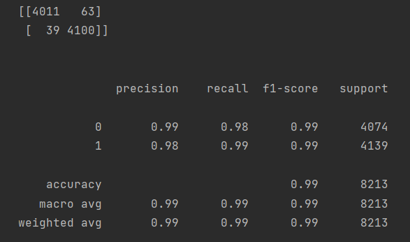
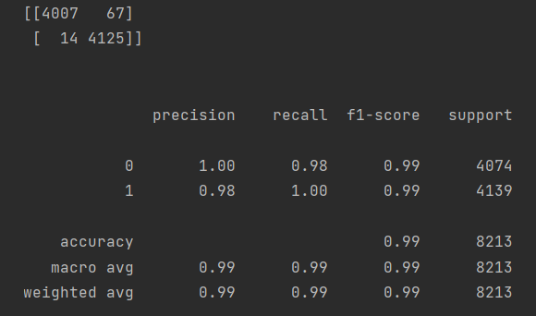
NAIVE BAYES
DECISION TREE
RANDOM FOREST

Slide 11
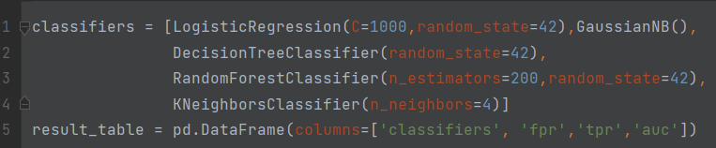
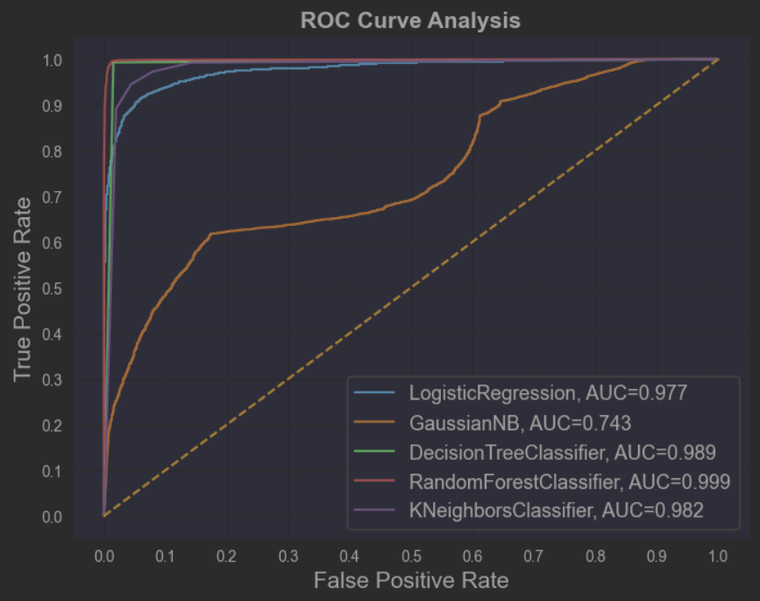
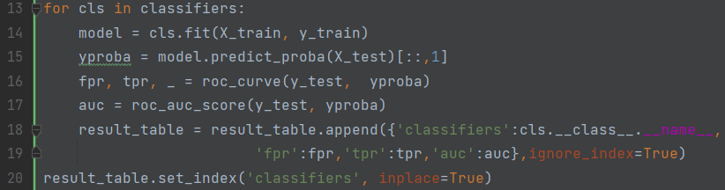
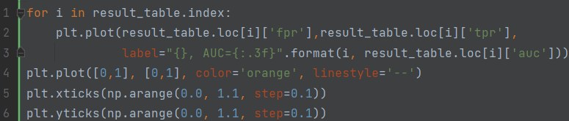
MACHINE LEARNING CLASSIFIER COMPARISON

Slide 12
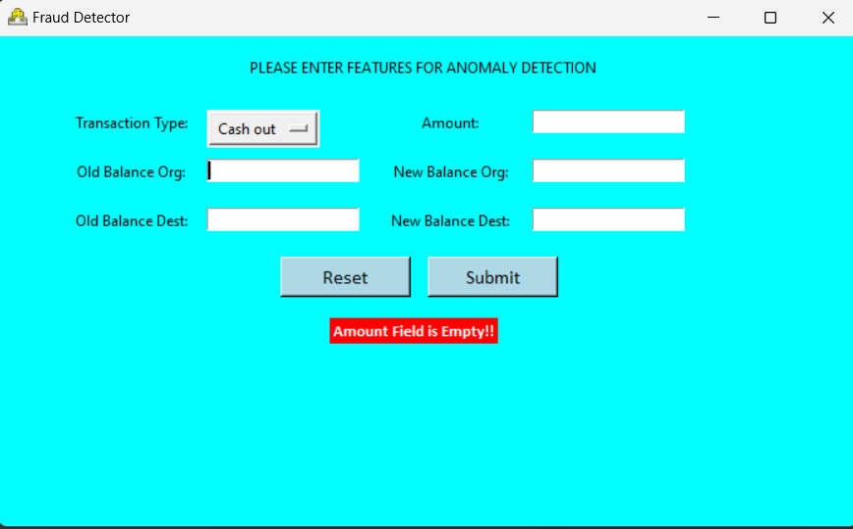
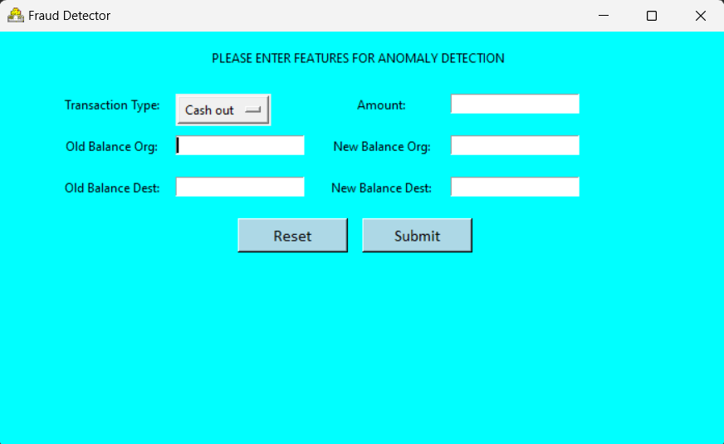
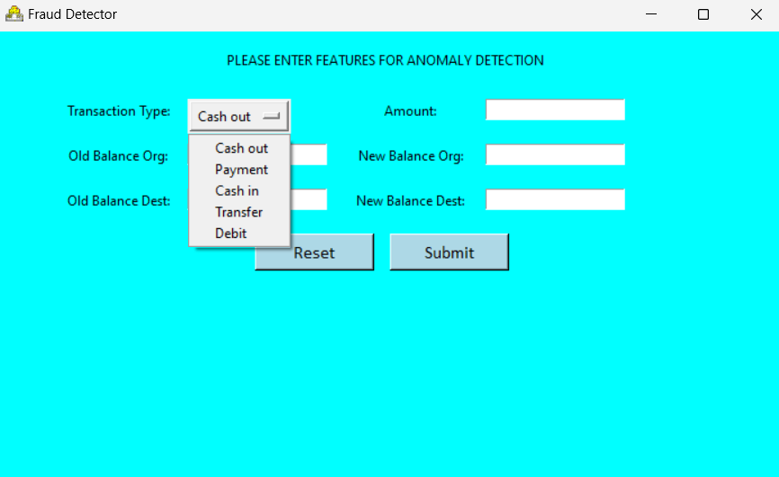
SIMULATION APPLİCATİON

Slide 13

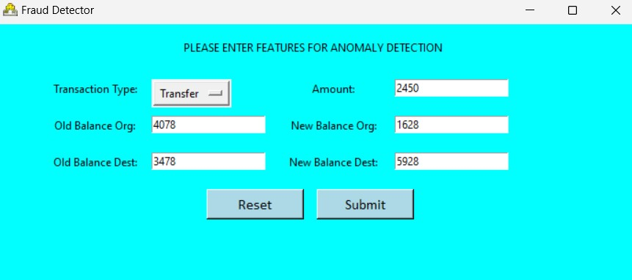
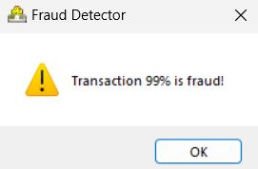
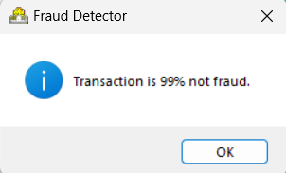
SIMULATION APPLİCATİON

Slide 14
Research

Slide 15
Thanks For Your Attention

